Slide 1
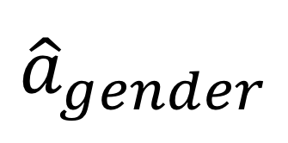
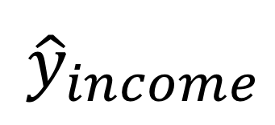
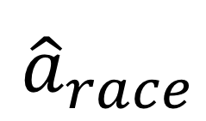
$${\hat{a}}_{gender}$$
Classifier
Adversarial
$${\hat{y}}_{income}$$
$${\hat{a}}_{race}$$

